Slide 1
March Update
dataaa

Slide 2
Thesis Progress
Due:
Outline
Prospectus move-over
Done:
Outline
In progress:
Prospectus move-over
Next:
Analysis Methods (Research)

Slide 3
Sample progress
T1 and T4 compression and testing have all been printed and are at Eric’s
T1 Hexagonal printing (0.4, 0.6, 0.8 infills) are currently being printed and will be done by their deadline of March 9
T1 Concentric printing (0.4, 0.6, 0.8 infills) will be printed afterwards

Slide 4
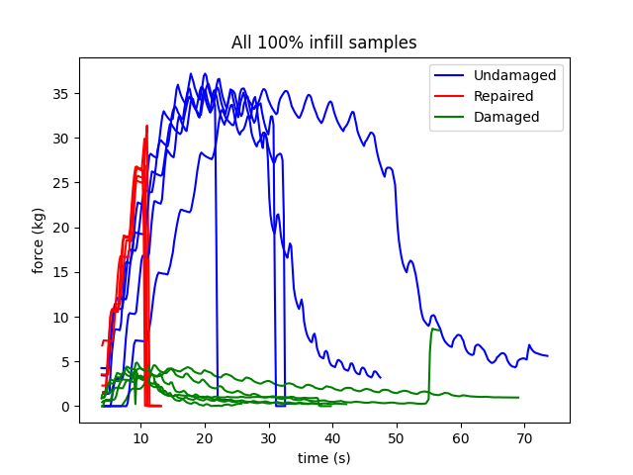
T1 Raw Data

Slide 5
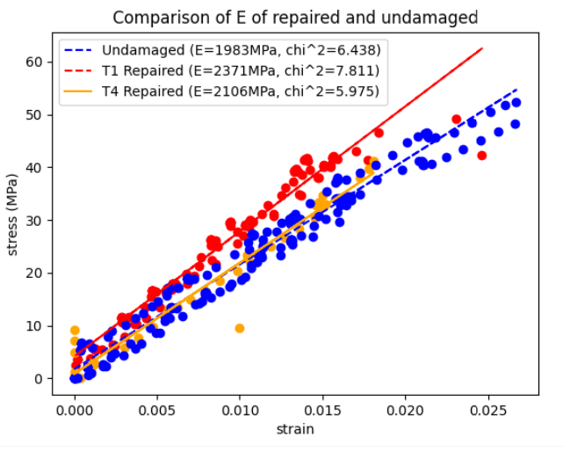
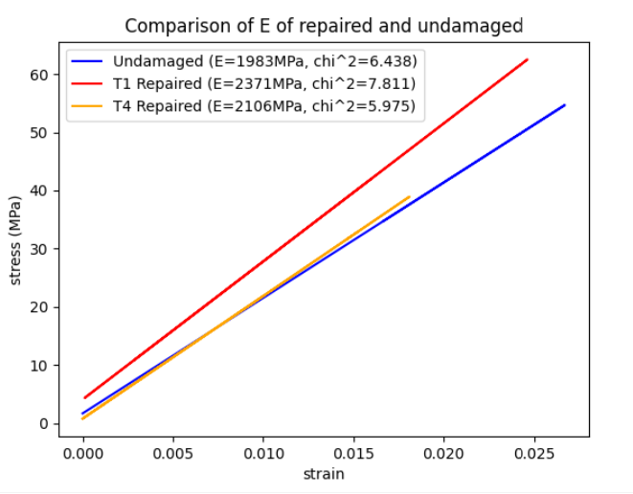
Aggregation, Young’s Modulus
Note: Only 1 T4 repaired sample has been tested

Slide 6
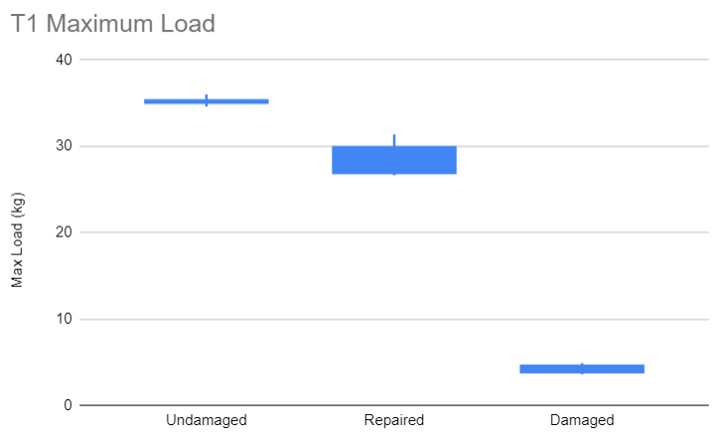
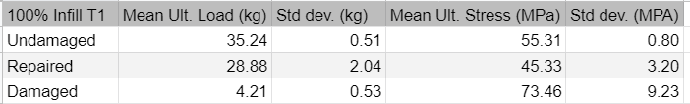
T1 Max Load

Slide 7
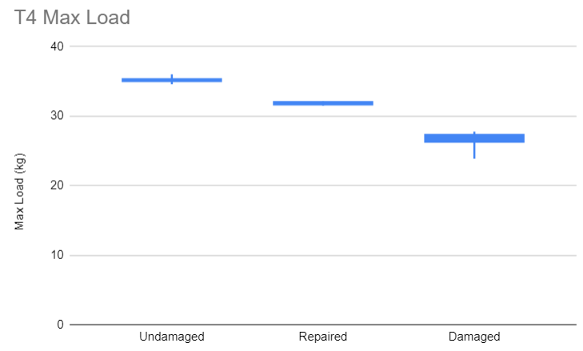
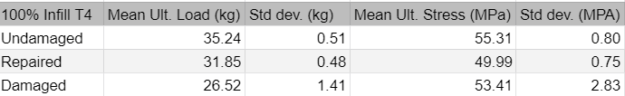
T4 Max Load

Slide 8
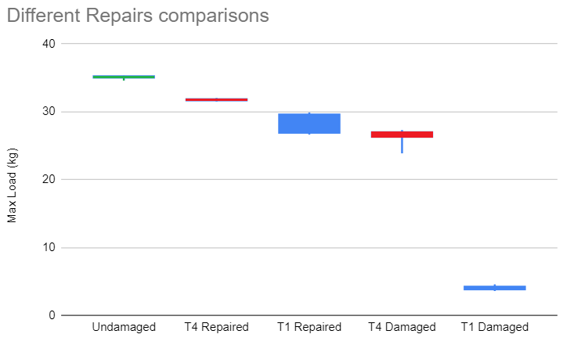
Comparison

Slide 9
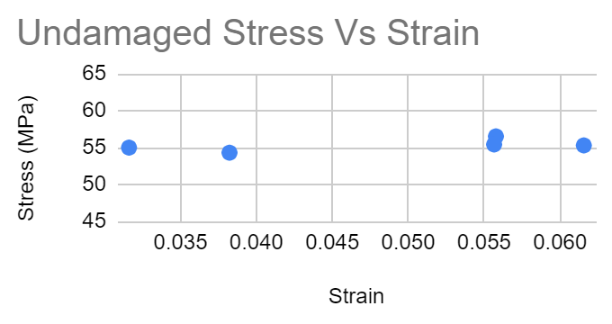
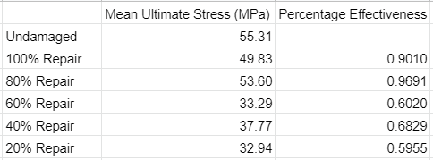
Implications
Stress data very consistent across parts at each infill
Strain data not consistent
Breaks before Ultimate Stress
Does not have a pattern for when it breaks
80% infill stronger than 100% infill
Will confirm difference in T4 tests
Notes:
Have number of test sample
List of factors we are changing
Pictures of infill
Statistics on just changing infill patterns
Consider out of plane loading

Slide 10
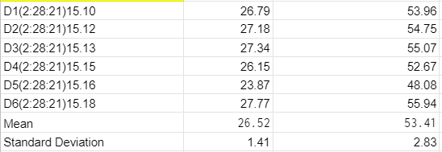
T4 Testing
Damaged tests completed
Repaired has higher maximum force
Repaired Stress similar to 100 percent infill of T1

Slide 11
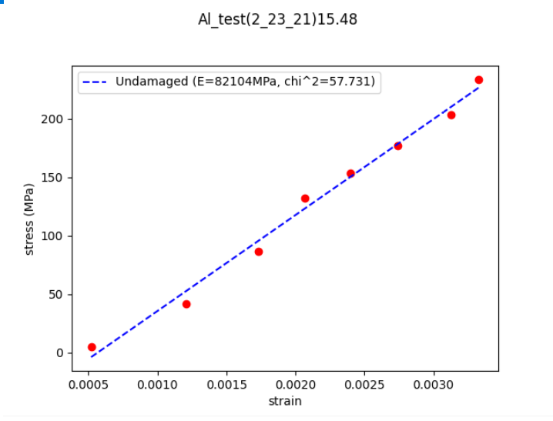
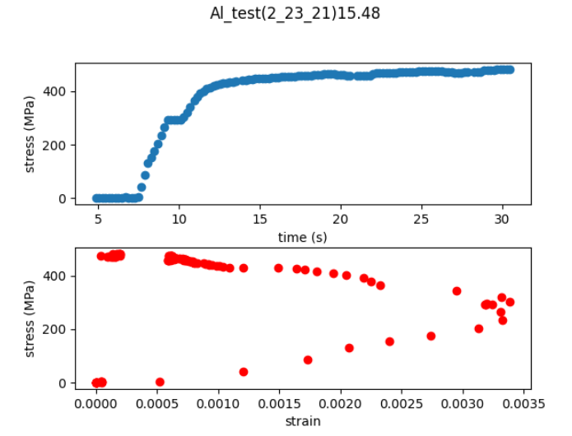
Aluminum Baseline

Slide 12
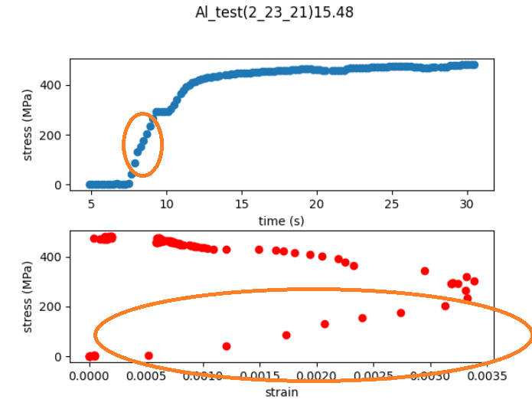
Aluminum Baseline
Should be ~69GPa :(

Slide 13

Test Videos
T4 Damaged
T4 Repair

Slide 14
Moving Forward
Test difference in infill patterns
Test difference in tension vs. compression

